Slide 1

杨苍沧
Globalization
Hosts:方凯盈
杨苍沧

Slide 2
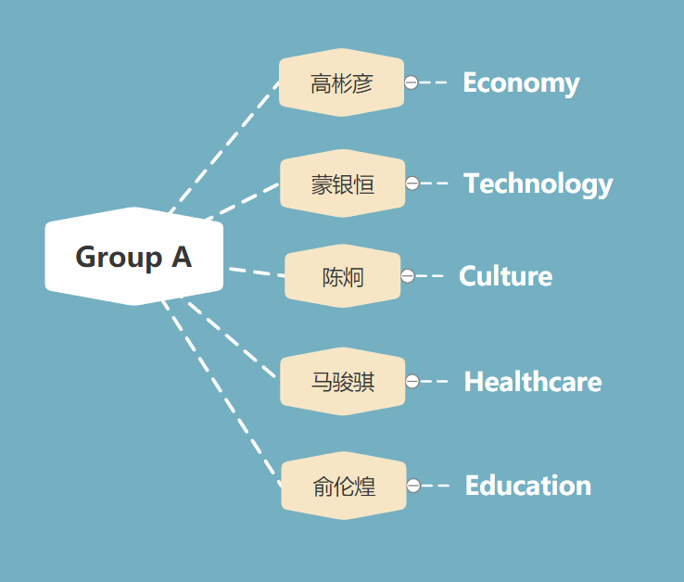
Group A
for
globalization

Slide 3
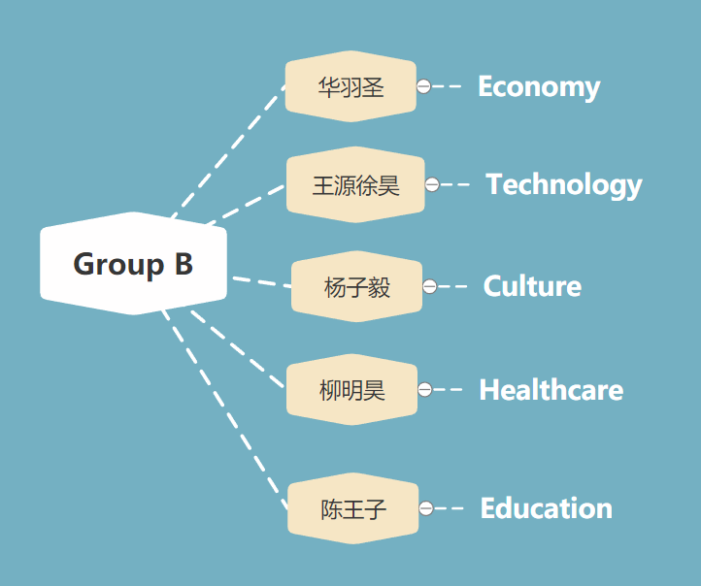
Group B
against globalization

Slide 4
Economy
Group A 高彬彦 for globalization
Group B 华羽圣 against globalization

Slide 5
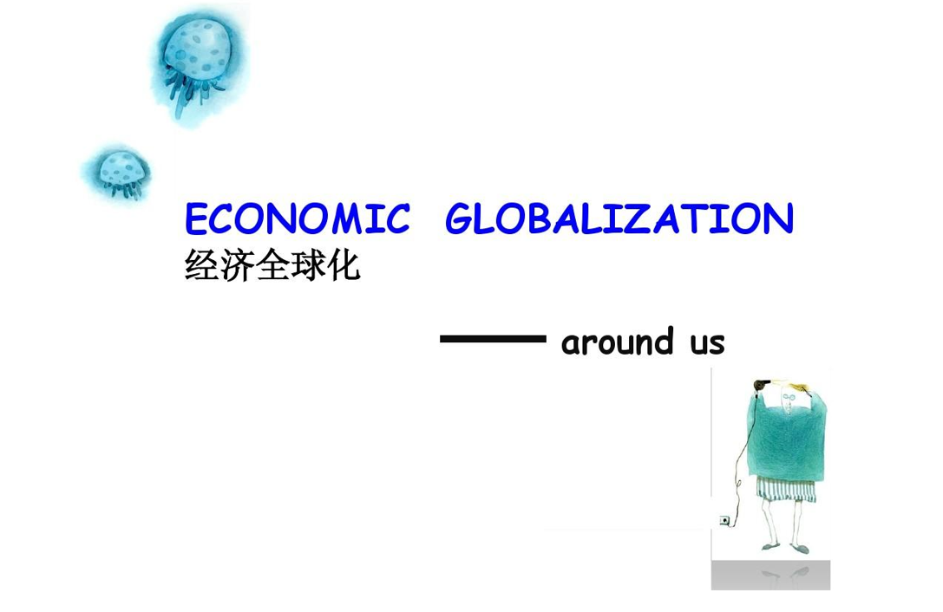
空白演示
单击输入您的封面副标题

Slide 6
The basic meaning of economic globalization:
Definition:It refers to the process that the world economic activities transcend national boundaries and form a global organic economic whole through foreign trade, capital flow(资金流动), technology transfer, service provision, interdependence and interconnection.

Slide 7
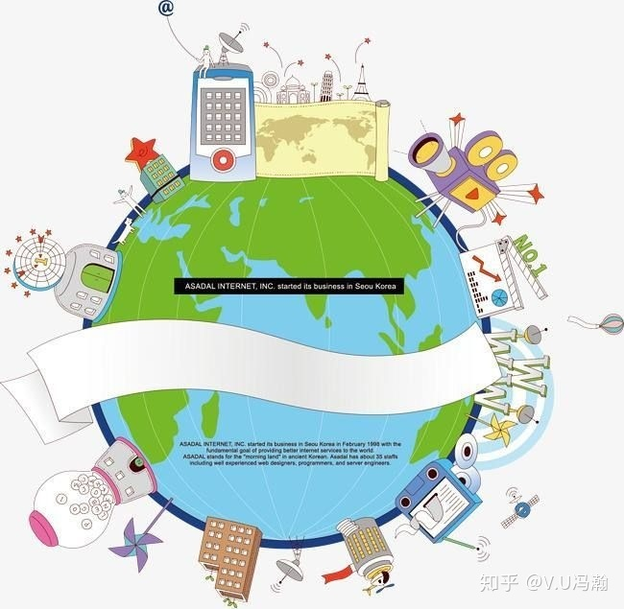
The advantage of economic globalization:
first of all, it is conducive to the optimal allocation and rational utilization of production factors in various countries. (有利于各国生产要素的优化配置和合理利用。)

Slide 8
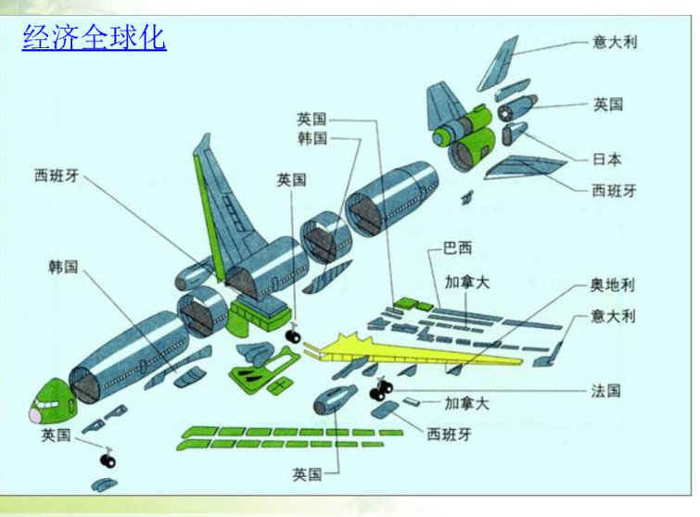
The advantage of economic globalization:
Secondly, it has promoted the rational optimization of economic structure and the great improvement of productivity.

Slide 9
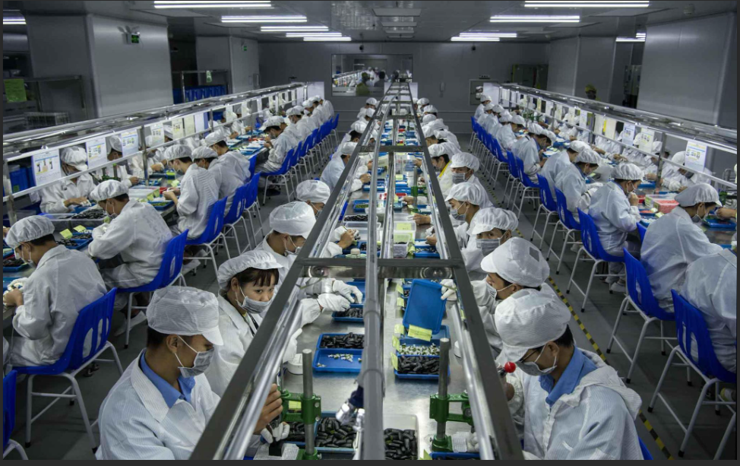
The advantage of economic globalization:
What’s more, it is beneficial to help solving the problem of surplus labor in developing countries.

Slide 10
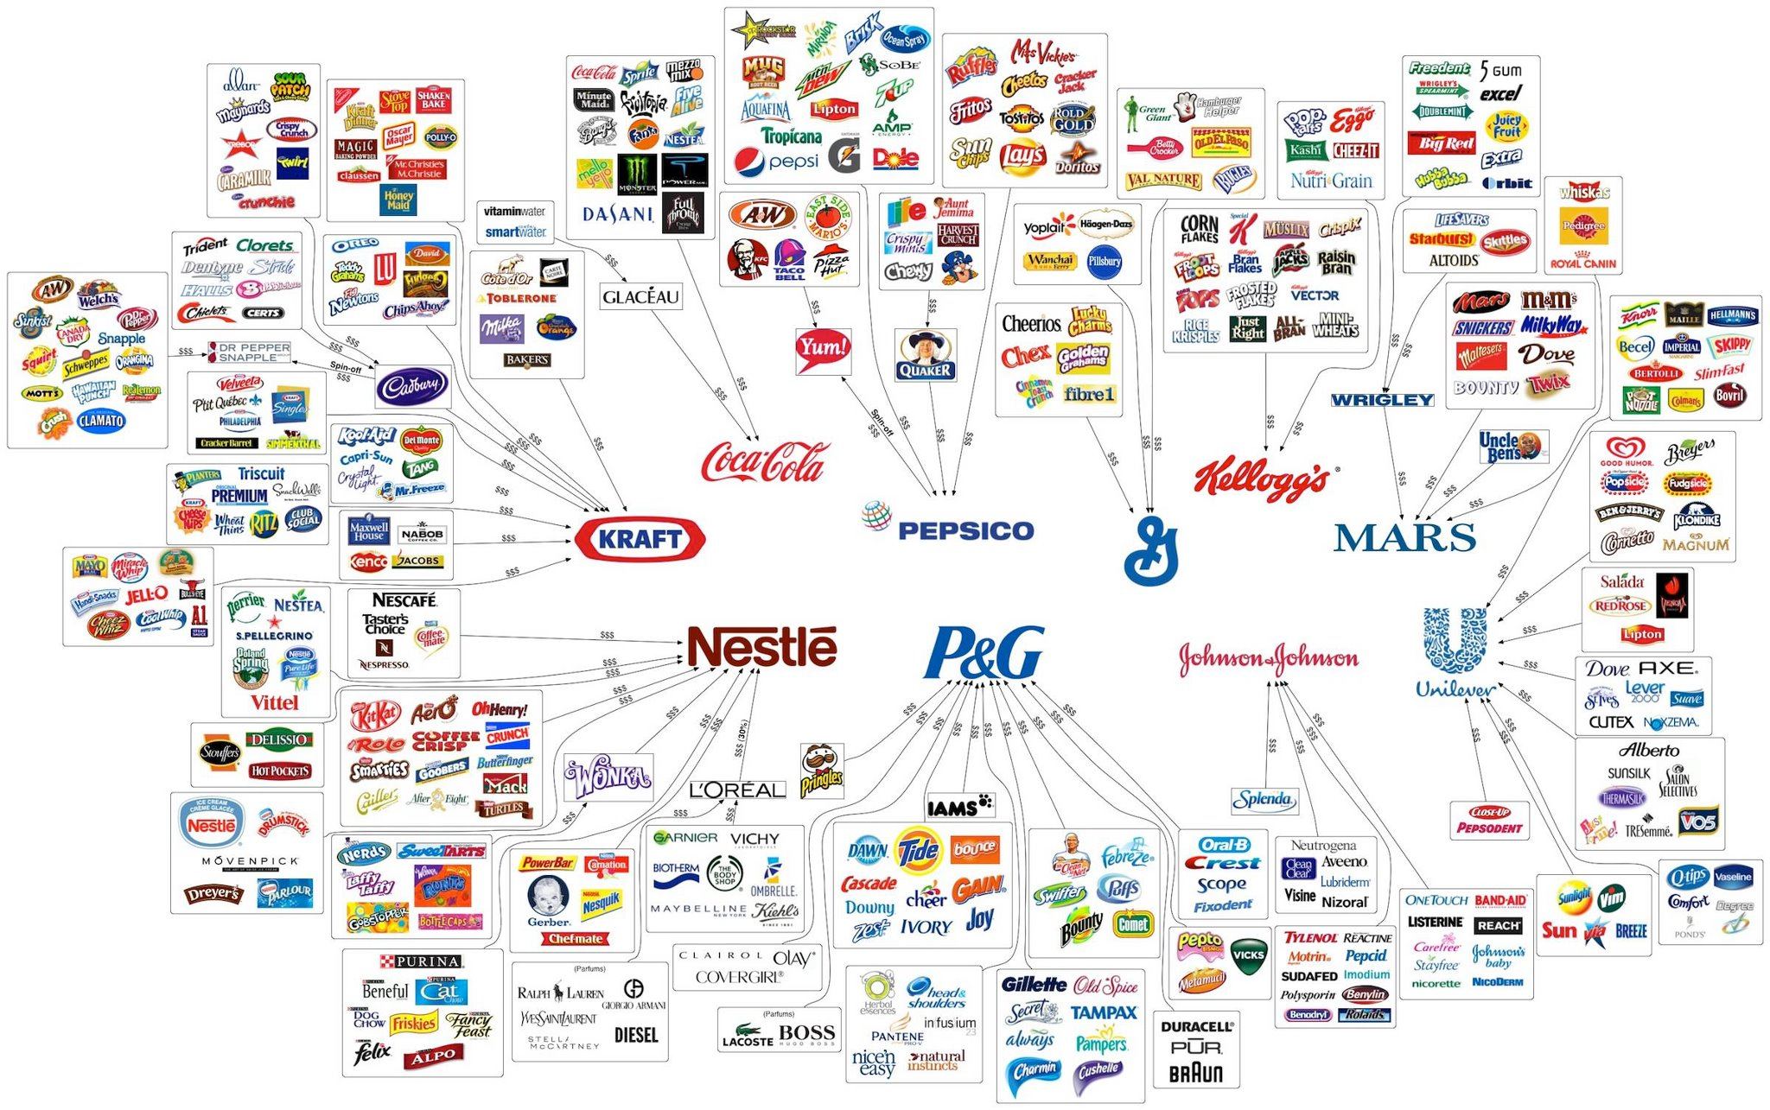
Threats of Big Companies

Slide 11
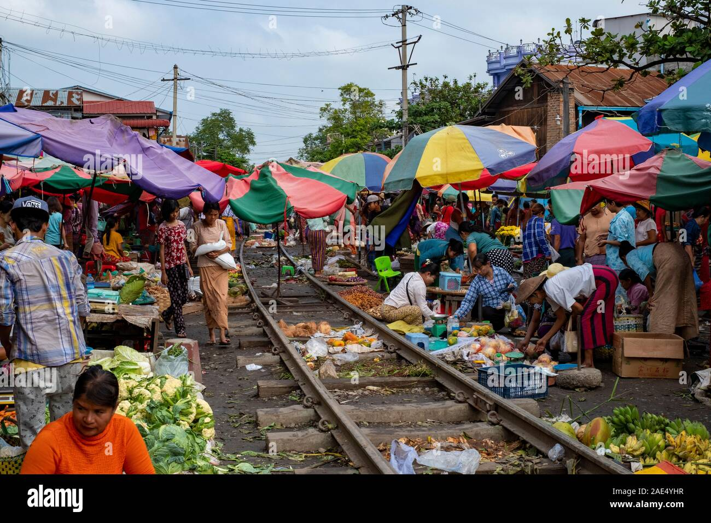
Affects Local Markets

Slide 12
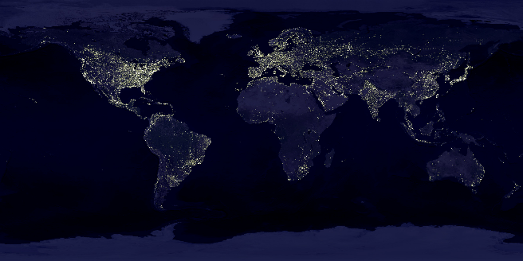
Disproportionate Growth

Slide 13
Technology
Group A 蒙银恒 for globalization
Group B 王源徐昊against globalization

Slide 14

globalization of technology

Slide 15


DEFINITION
The globalization of technology mainly reters to the global recognition of human science and technology activities, the free movement and rational allocation of the elements of science and technology activities on a global scale, the sharing of scientific and technological activities worldwide

Slide 16


Slide 17
02.
reduced the cost of research and development
04.
Facilitate people's lives
ADVANTAGE
01.
Contribute to the integration and allocation of global resources
03.
Provide more opportunities for research cooperation of scientific researchers

Slide 18
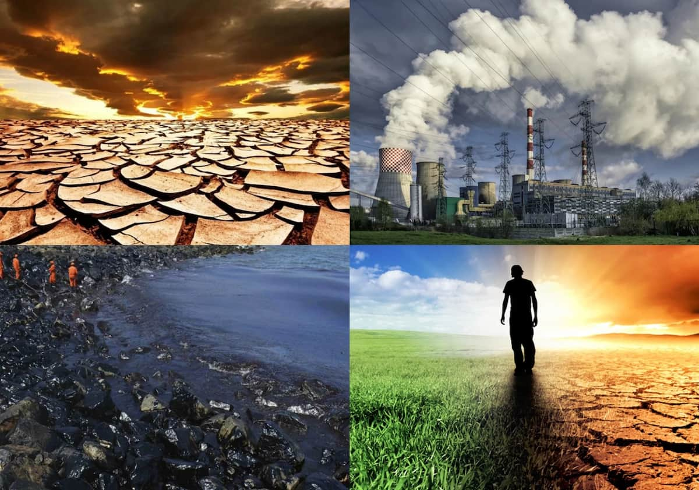
Environmental Concerns

Slide 19

Wastage of Resources

Slide 20

Patents and Copyrights

Slide 21
Culture
Group A 陈炯 for globalization
Group B 杨子毅 against globalization

Slide 22

CULTURAL GLOBALIZATION——a process of exchange and integration of different cultures.

Slide 23

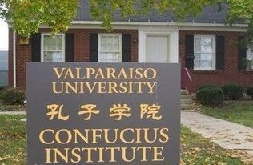
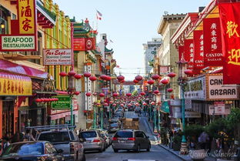
it enriches the vision of Chinese culture, makes Chinese culture go to the world,
and makes more people understand the
breadth and depth of Chinese culture.

Slide 24


At the same time, Chinese culture has also absorbed the essence of other cultures.
The road of socialism
with Chinese characteristics
Communist thought and Marxist thought

Slide 25
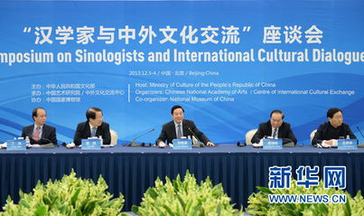

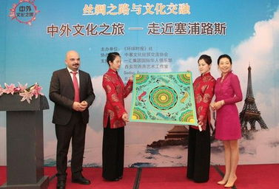
Through the joint efforts of the people of the world, the possibility of cultural conflicts among countries will be greatly reduced, and the world culture will enter a new stage in conflict and integration, absorbing and tolerating each other, seeking common ground while reserving differences.

Slide 26
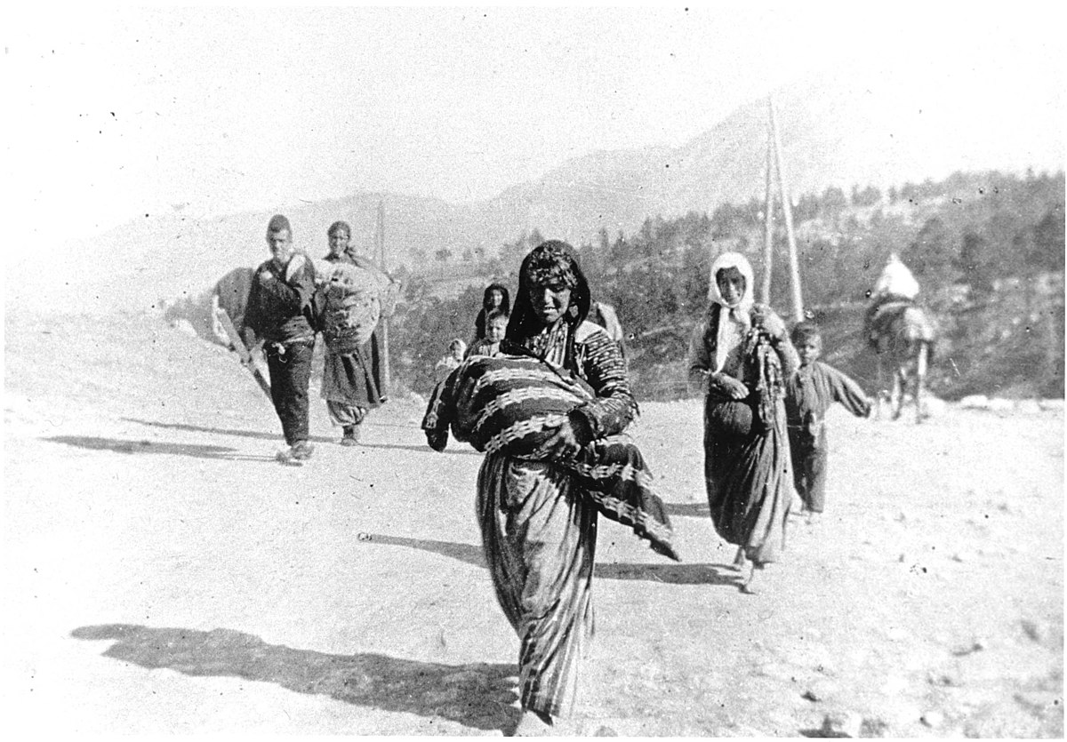
Destroys Ethnic Cultures

Slide 27

Social Divides Exploitation of Labors

Slide 28
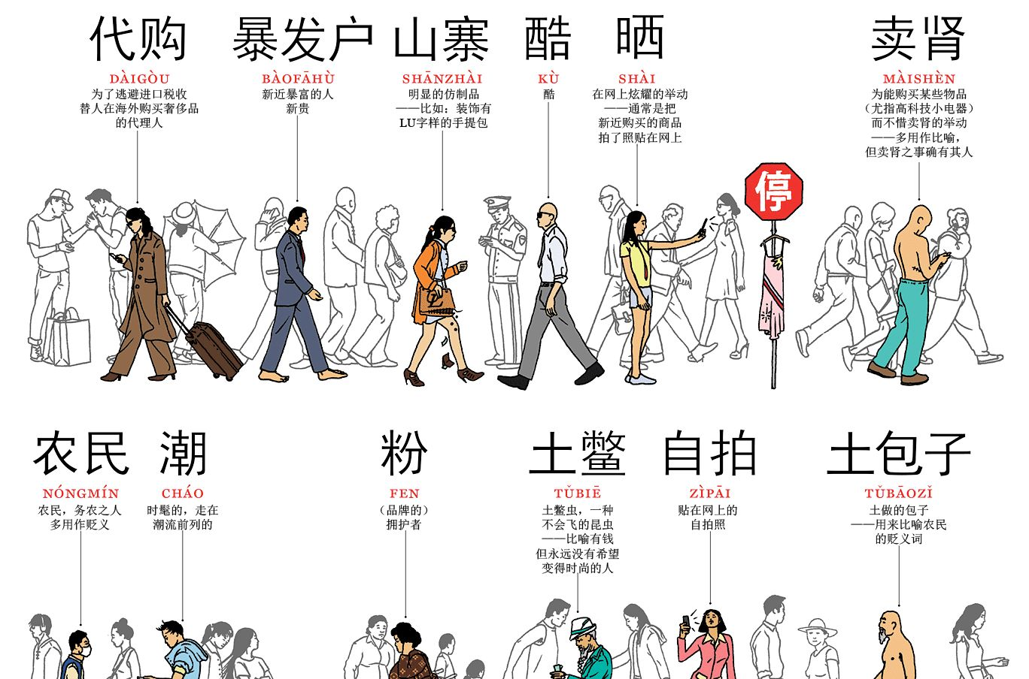
Commercialism and Homogenization

Slide 29
Healthcare
Group A 马骏骐 for globalization
Group B 柳明昊 against globalization

Slide 30

Globalization of healthcare

Slide 31

1.Timely control of some sudden infectious virus Through the sharing of medical resources in various countries

Slide 32
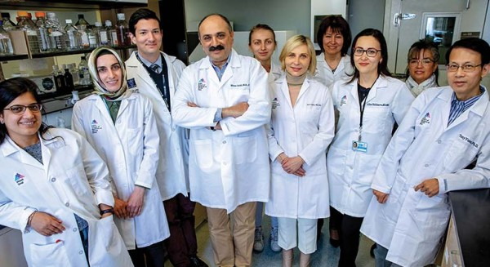

Medical resource sharing during Novel Coronavirus
The global collaboration to develop a COVID-19 vaccine is 90% effective
Teams from China and the US work together to develop COVID-19 vaccines

Slide 33

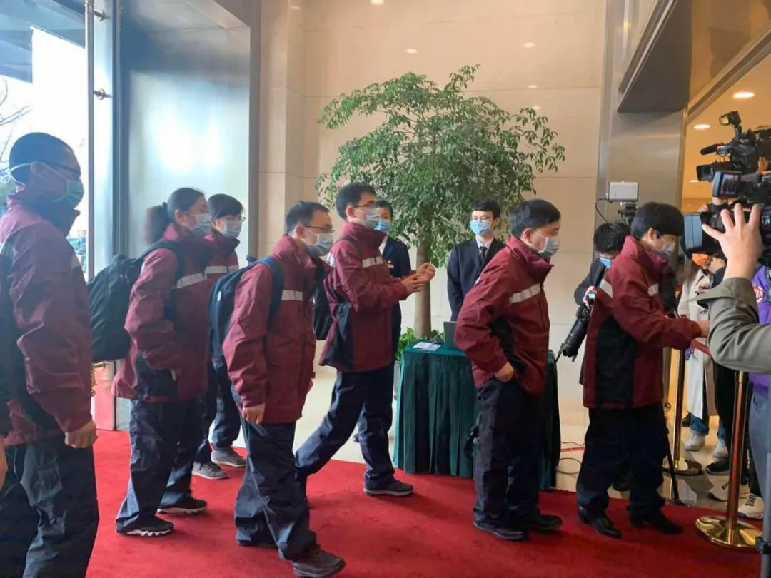
The benefits of medical globalization
2.Promoting medical innovation
Through the introduction of foreign advanced medical technology and medical cooperation
3.Training medical talents
By sending students abroad to study advanced medical technology, exchange and learn from each other

Slide 34
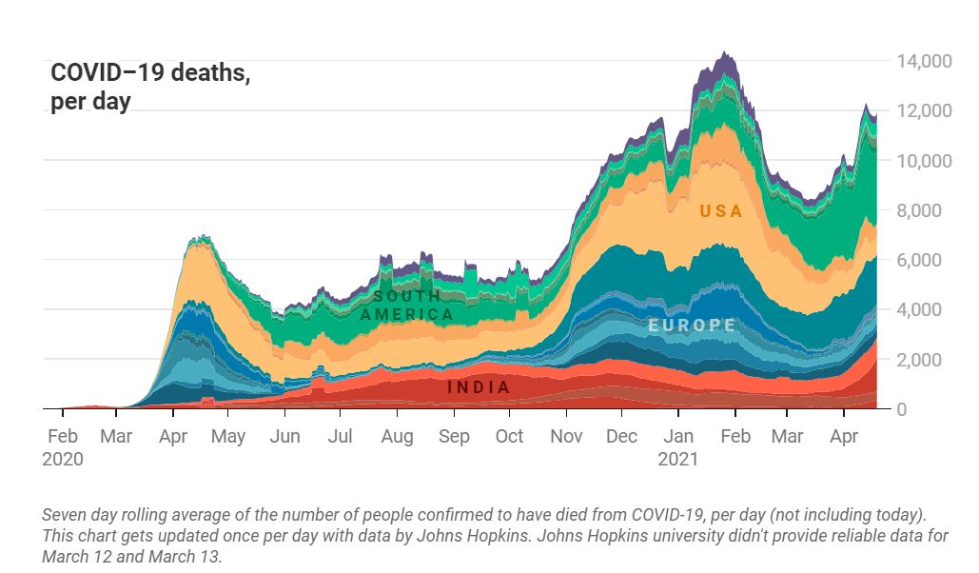
Danger of Spreading Diseases

Slide 35
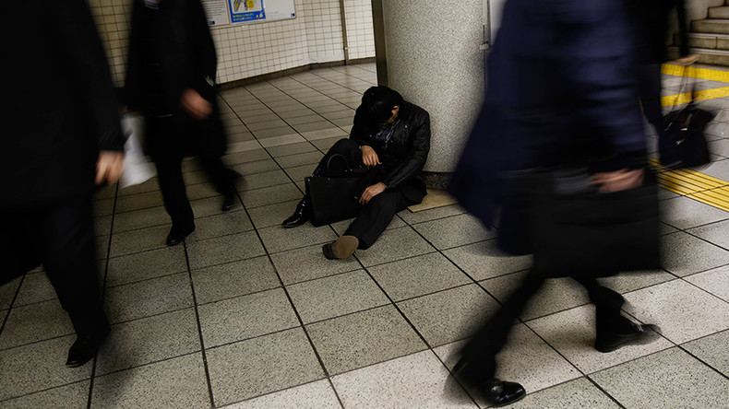
Health Risks and Karoshi

Slide 36

Welfare under pressure

Slide 37
Education
Group A 俞伦煌 for globalization
Group B 陈王子 against globalization

Slide 38

Globalization of education

Slide 39




Driven by the globalization of the world economy and trade liberalization, the globalization of education has also emerged.
improve the level of international education
create an international educational atmosphere
is the inherent need of educational development and the inevitable requirement of the development.
Notes:
It can improve the level of international education and create an international educational atmosphere, which is the inherent need of educational development and the inevitable requirement of the development of the times.

Slide 40



Although globalization is an unequal sharing of resources, education in developing countries has indeed grown. More talents have received excellent education.

Slide 41


Right now, we are in an era of openness.
Student flow and exchange from different countries
Cultivating talents with global competence for the country and the world
Accelerate the development of the country
Realize the sustainable development of the world
Notes:
Right now, we are in an era of openness. Studying abroad is not only a way for students from different countries to flow and exchange, but also an opportunity to cultivate talents with global competence for the country and the world. Studying abroad enables students to have an international perspective and international sentiments, thereby forming the ability to take responsible actions for the development of their own countries, the common well-being of mankind and the sustainable development of the world.

Slide 42

the brain drain

Slide 43

Increased Competition

Slide 44


Slide 45
Thank you!

